Slide 1
The one who's missing
Shark tank 40%
Lorenzo Arenas Ramirez
8-C

Slide 2
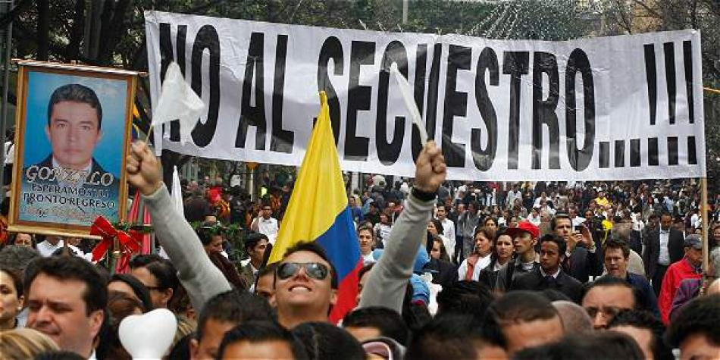
What theme did I chose? Why?
The theme I chose was to make a critique to all of the cases of Kidnapping and desapearing in Colombia. This has been one of the most present cases of Colombian society and we still have no solution.
I decided to choose this theme because I think that Colombian society and Colombian families are always searching for answers of the missing people. If the guerrillas are going to give them back; If some day will there be peace. Many questions and NO ANSWER. I decided to critique and how the importance of this theme.

Slide 3
References
2D:
Oscar Muñoz (Conceptual)
Banksy
3D:
Doris Salcedo (Conceptual)
Günther Uecker
Man Ray

Slide 4
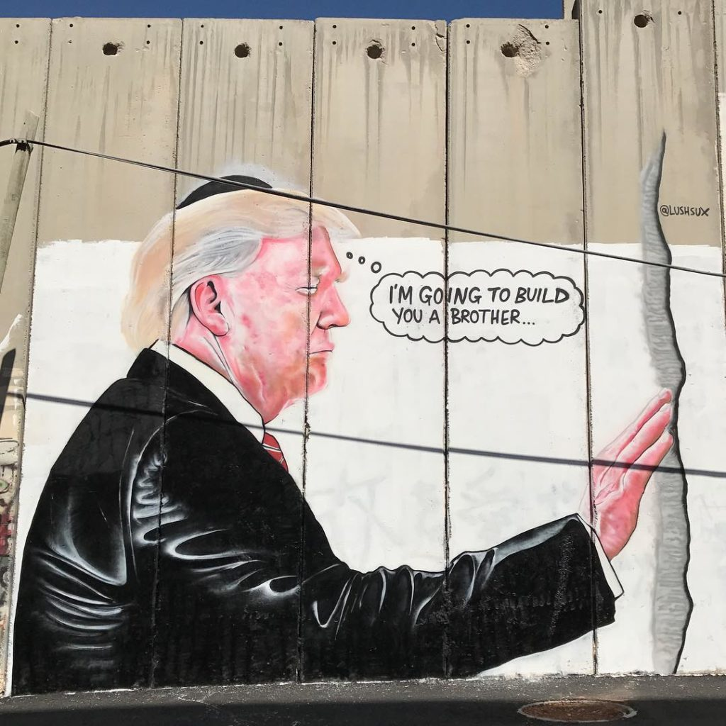
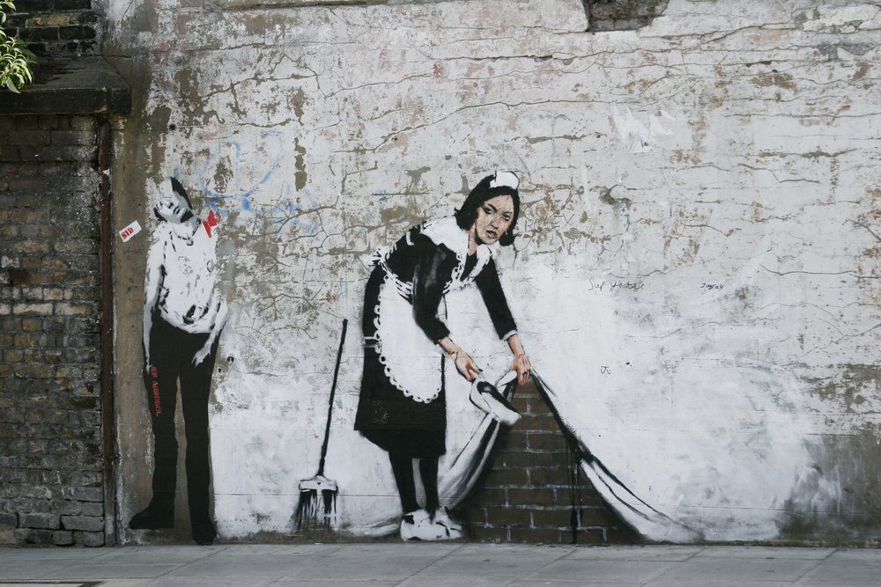
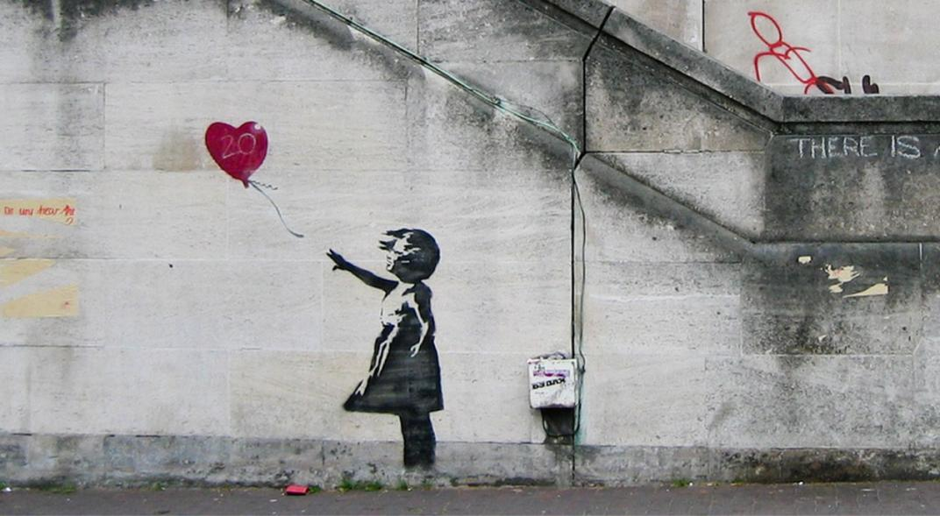
Banksy
Banksy is a British Artist from London. His art works usually present a critique to the European or to the actual society by different new types of painting such as graffiti or interaction with the background.
Banksy helps me as 2D reference because, as I already mentioned, Banksy usually present art works that interact with the back ground and make a social critique. Also I can use him as reference for the stencil style.

Slide 5
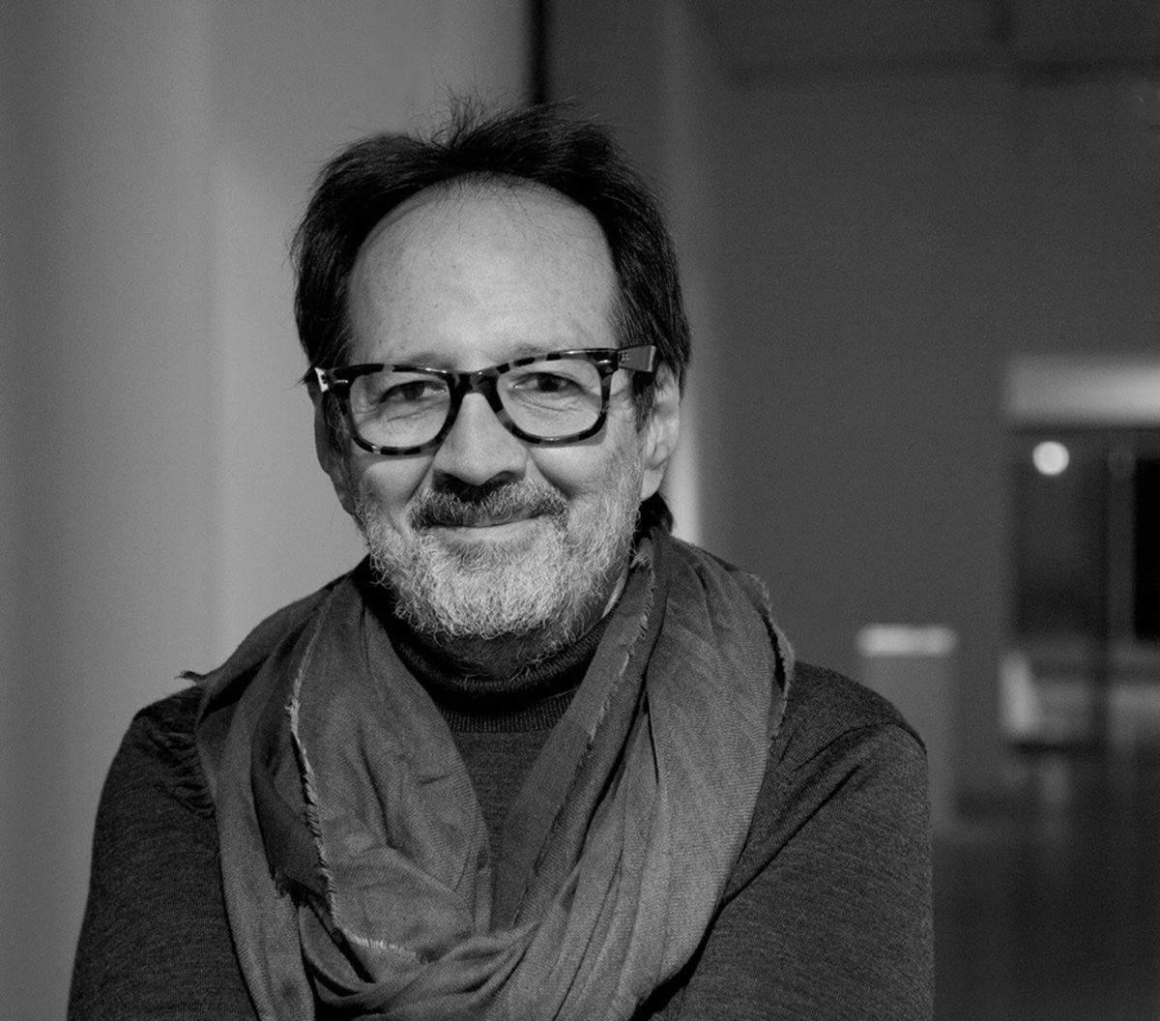
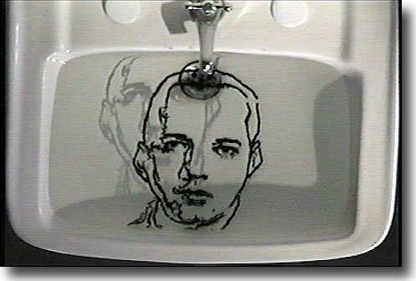
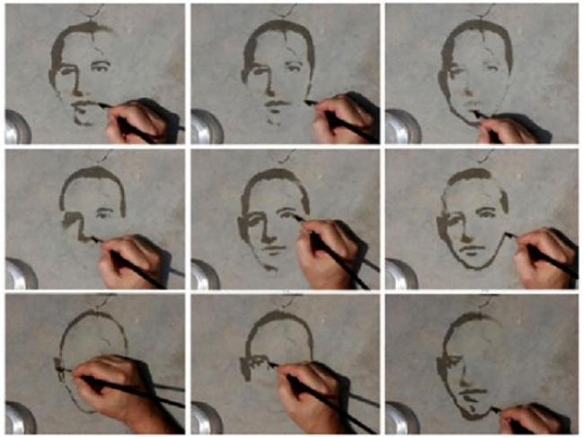
Oscar Muñoz
Oscar Muñoz is a Colombian Artist born in Popayan in 1951. This artist usually treats the themes of death, missing and kidnapped people.
I selected Oscar Muñoz as one reference to 2d painting because he is an artist that helps me to understand better the concept of Missing people or of kidnapped people. I also like the concept of despairing of some of his art works. For example he uses this concept in his art work in the rocs using water to paint. In this art work the portrait disappears after few seconds due to the sun.

Slide 6
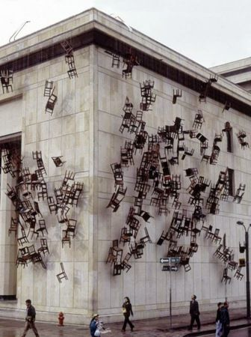
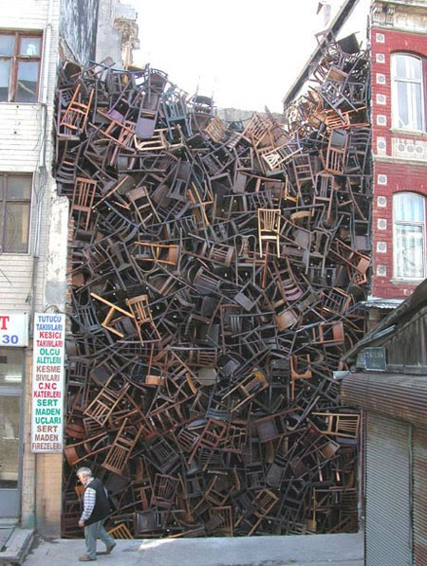
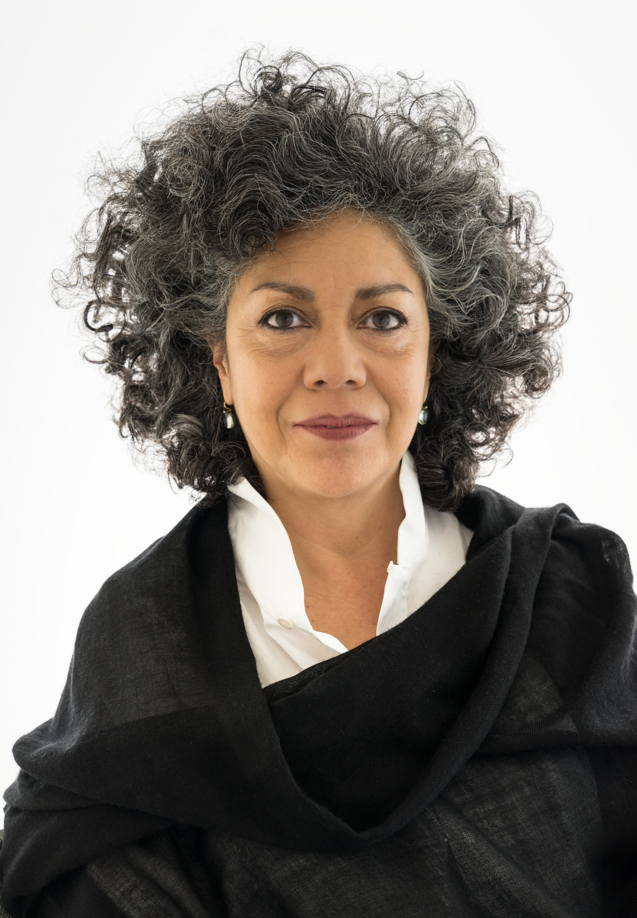
Doris Salcedo
Doris Salcedo is a Colombian Artist born in Bogotá. She has made different sculptures and 2D artworks in memory of the Kidnapped victims or in honor of the death people in the tragically “overcome of the palace of justice”. Her art pieces usually present new forms of painting such as assemblage or new materials for painting.
Doris Salcedo, in terms of conceptual approach, helps me as a reference because on some of her artworks, such as the empty chairs in the Justice Palace, she works the topic of missing people. She is a reference of new forms of sculpture because she usually uses assemblage of objects to create artworks.

Slide 7
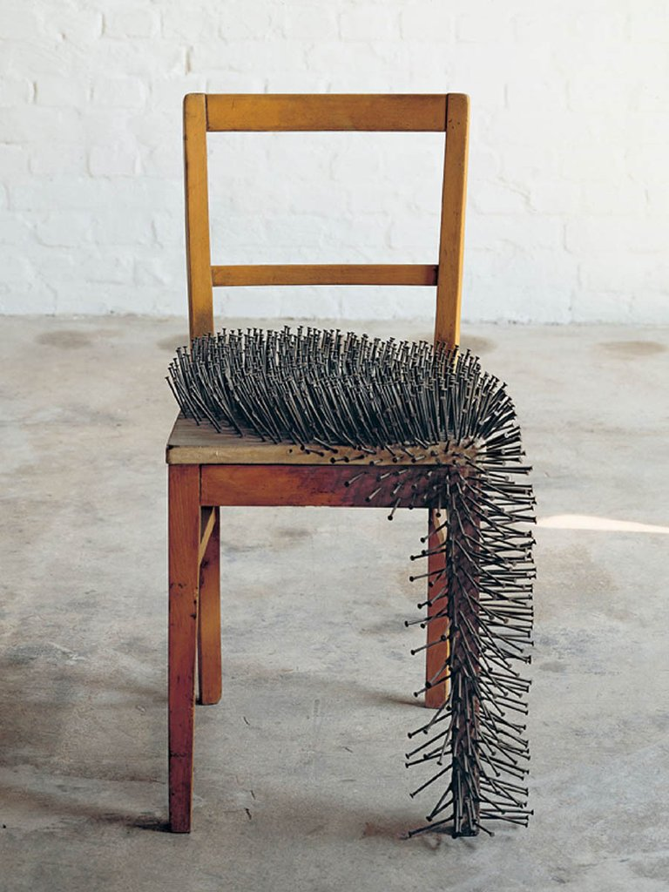
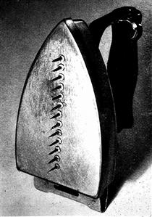
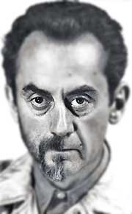
Man Ray and Günther Uecker
Man Ray was an artist and Photographer born in 1890 in Philadelphia. He usually searched to show a free message or a feeling he had about the actuality.
Günther Uecker is a German artist born in 1930.
Man Ray and Günther Uecker are both good examples of new forms of sculpture. They both present art Works with objects but assembling them to nails or different objects which make them change the context and perspective of the object.
Günther Uecker

Slide 8
sketch

