Slide 1
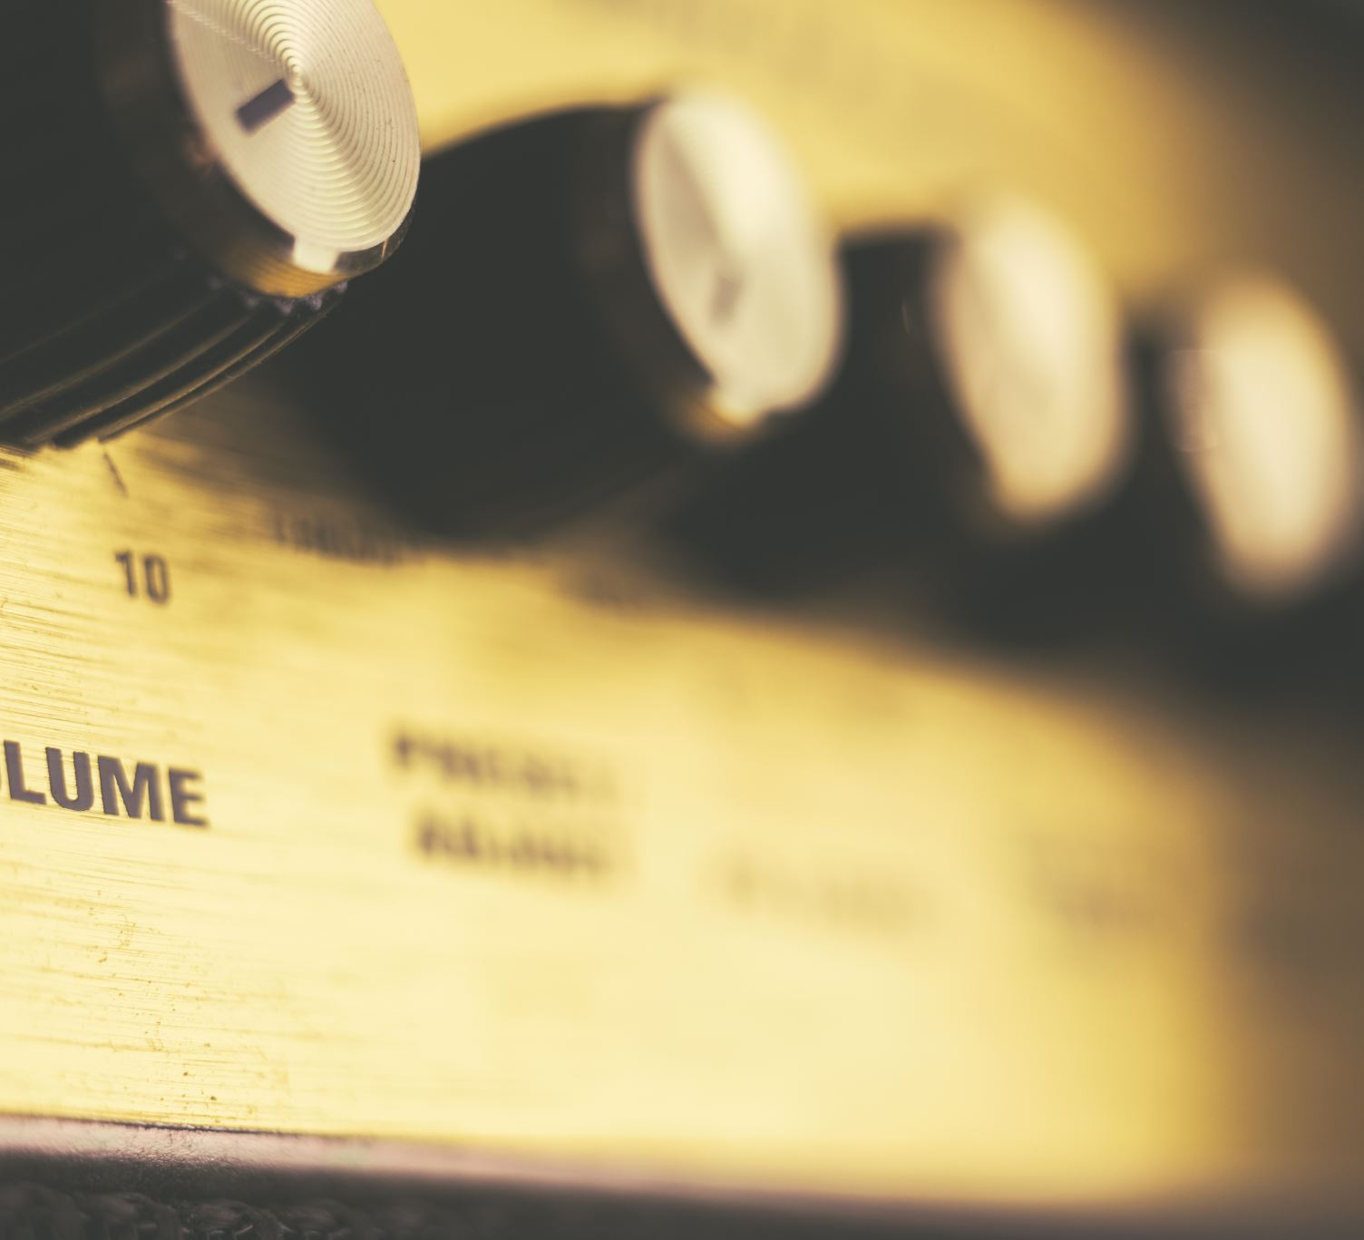
MIDI
Juan David Arana, Lorenzo Arenas, Tomas Garcia, Felipe Barbosa
8C

Slide 2
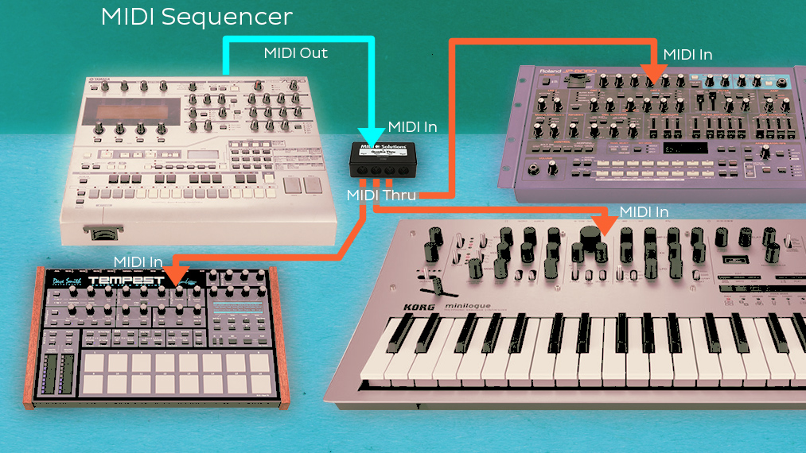
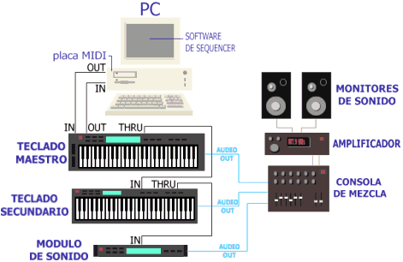
What is MIDI
Stands for Musical Instrument Digital Interface.
Is a type of interface for musical instruments and devices.
Its an standard that allows the communication between different kind of music devices, and this standard includes the electronics and the structure of data required to enable such communication.
Its a set of specifications agreed by the electronic music industry as a whole that describes the hardware standards that a divice should have in order to recieve and transmit information and the form that this will take.
Midi has the function to transform actions developed on a instrument or device into messages that are sent to another, the listening device identify these messages and responds on the way that they are programmed to respond.
Midi does not transmit audio signals.

Slide 3
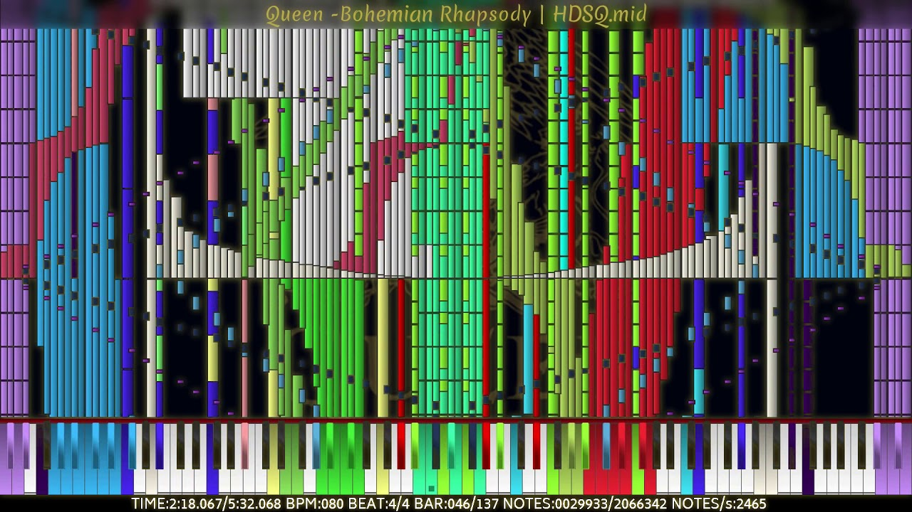
Example.Queen: Bohemian Rhapsody - 2.06 Million Notes - Black MIDI
https://www.youtube.com/watch?v=HjwzR3BqMZ4

Slide 4
MIDI history
"The beginnings of the midi began in 1860 when Hermann Von Helmholtz, began to use electronics to form sounds, he built electromagnetic generators that produce pure sounds. Years later in 1897, Thaddeus Cahill built the first synthesized which was nicknamed as Dynamophone which was a machine responsible for producing alternating currents at different frequencies with the purpose of producing music in a different way. In 1961, Harald Bode using the potential that the synthesizers had, created the Melochord which was the first synthesizer that is controlled by high voltage, creating the Melochord, considered as the first synthesizer controlled by high voltage. Shortly after in 1964, Robert Moog launched the moog synthesizer and Donald Buchla an electronic system called Buchla, these two were responsible for improving music production technology and being able to build instruments that can be used digitally, which caused many rivalries between different companies. In 1981, companies such as Sequencial Circuits, headed by Dave Smith and Chet Wood, developed a communication protocol which had the function of connecting different devices in oneself and also making it a standard referring to what can be used by more people."(Magazine, 2019)

Slide 5
"A year later in 1982, some manufacturers improved this machine by giving it a better sound, transmission speed and taking away any interference or noise problems, then a Japanese company improved it by making it more powerful and better done by creating the MIDI which its meaning It's Musical Instrument Digital Interface. From the creation of the midi began to create better devices and softwares with which you can produce digital music with different sounds and instruments. Keyboard and different things were created which are connected to a computer with the capacity to produce new and many quantities of sounds, these are also capable of being connected by means of cables and joining different instruments in one piece which has revolutionized the musical production of the present."(Magazine, 2019)

Slide 6
HOW TO USE MDI ? https://www.youtube.com/watch?v=_trsho9eiDQ

Slide 7
Midi instruments and controllers
Midi music works thanks to Electronic Synthetisers or instruments. Synthetisers base them selfs on analoge electronics to work, these use electronic Voltages to create, diferenciate and controll all of the different sounds in one song. Electronic synthethisers connect to computers or to electronic devises in which the frecuense is sent and the sound is controlled.

Slide 8
Synthetizers
Sound Synthetizers produce the sound thanks to waves. The Synthetizers create waves forms in which the author or composer can decide and edit the; frequency, intensity, duration or timbre. All this factors create the sound that the composer wants.
The synthetizers also have the function to traduce the information controllers send them and translate it into music or waves, to be able to produce the sound.

Slide 9
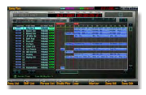
Controllers
The controllers in Midi is the capability or the way in which you can play virtual instruments and sounds on your computer. Many MIDI controllers can look or see as usall instruments, however, Midi controllers translate what is beeing played on them and transforms it into Musical Instrument Digital Interface(MIDI) information which is sent to the Synthetisers or the computers, generating the sound
Controllers can befound in different instruments such as Pianos, Drumps or Guitars.
Controllers can also be divided in sections making them have different sounds or frequencies. For example in one keybord you can divide it in sections and decide which parts of the keybord controll which instrument.

Slide 10
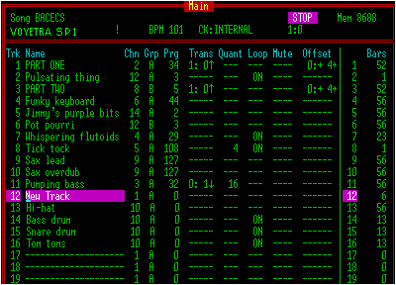
MIDI channels
In MIDI there is the channels which are, types of rutes of comunication or access to information. Usually a 5 pin(the only real sender of MIDI information) midi cabble can have 16 channes, however, options of comnication suchs as bluetooth or wifi can also include 16 channels.
Midi channels can also help diferenciate and communicate the different messages or data to the diferent devices or instruments. This information and sounds usually come from the different controllers that the author uses. Each channel recives the information of a different controll to produce the different sounds.
Many times Muscitians can modify the instruments to joust recive some specific channels information. Fro example some keybords can be set to only recive information from channel 3, all of this can be set by the MIDI specification.
Midi channels usually correspond to a MIDI number based on their timber or patch(particular timbre generated by a synthesiser). To controll all the timbers possible artist need a sound generating device with big memory device

Slide 11
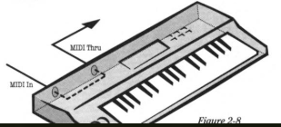
MIDI IN/OUT/THROUGH
MIDI instruments can have many ports pannels or displays but the most important are MIDI IN/OUT /THROUGH
MIDI IN: The MIDI in part is in charge of reciving the MIDI data and sending it to the instrument's computer. One's the information is there it's analized and acts as a performance of the instrument itself.
MIDI OUT: As you perform actions on the MIDI keybord, your actions are analized and turned into codes. This data is sent out thanks to the MIDI out plug and is sent to the different synthetisers.
MIDI TROUGH: this third channel or plug helps on sending the data in a chain. It can also repeat and duplicate the data replied by the MIDI in plug.

Slide 12
MIDI IN/OUT/THRU
Watch till minute 2:38 for general explenation
Watch from the minute 2:45 till the end for demostration and feedback

Slide 13
MIDI Types of message
MIDI is based in the comunication of synthetizers or controllers and the different messages that this have to produce the sound. A message is compossed of 8 bit-status byte(portion of a MIDI message that defines the type of information being sent) and has aditionally between one or two data base bytes. the messages can be generalized and divided in two categories: Channel messages and System messages.
According to MIDI.org "Channel messages are those which apply to a specific Channel, and the Channel number is included in the status byte for these messages. System messages are not Channel specific, and no Channel number is indicated in their status bytes."(2019). In addition, the channel messages can have two sub categories which are Channel Voice Messages, or Mode Messages.

Slide 14
MIDI Types of messages
To read the MIDI protocol you must first understand how to read binary. Binary is composed of a series of “on” or “off” values called bits. Bits are read in 8bit groupings called bytes and these have a decimal value in MIDI.
A byte that begins with a 1 on its left most side is called a status byte. A byte that begins with 0 is called a data byte

Slide 15
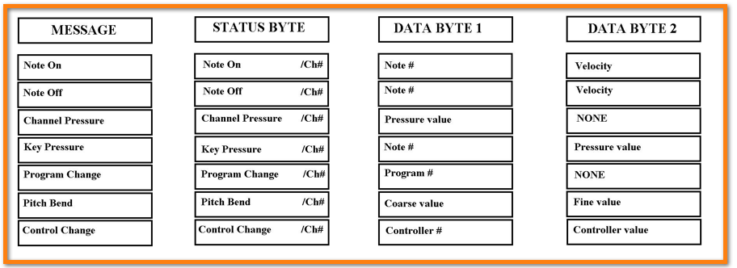
Mode messages
Mode messages are the only “channel messages” that affect the entire MIDI device and aren’t channel specific. They are control change messages 120-127
Each channel voice message is composed of a status byte and an undefined number of data bytes. The number of data bytes is technically listed as “undefined”, but for clarity and simplicity its easier to visualize each MIDI channel voice message as having one status byte and two data bytes.
https://www.wikiaudio.org/midi-channel-messages-tutorial/

Slide 16
Channel messages
There are 7 MIDI channel voice messages and each one is defined by the first four bits of its status byte. The last four bits (nnnn) of the status byte define which MIDI channel the message is sent on. Four bits = 16 values ( 0-15) . This is why MIDI has 16 channels.
Note on (status byte 1001nnnn)
Note Off (status byte 1000nnnn)
Mono Pressure (status byte 1101nnnn)
Poly Pressure (status byte 1010nnnn)
Program Change (status byte 1100nnnn)
Pitch Bend (status byte 1110nnnn)
Control Change (status byte 1011nnnn) (Mode Messages are control change messages)

Slide 17
Channel voice message

Slide 18
Questions
How do the MIDI controllers help on the music creation? or what is their function?
Which are the different channels or plugs that a keybord can have?
What is the meaning or for what stands the expression MIDI?
What is the function of synthetizers?
Are synthetizers and controllers related?

Slide 19
sources
Magazine, D. (2019). Historia del MIDI. Retrieved 3 December 2019, from http://www.diffusionmagazine.com/index.php/biblioteca/categorias/historia/335-historia-del-midi
Rona, J., & Schiff, R. (1994). The MIDI companion. Milwaukee, Wis.: Hal Leonard.
Chan, T., & Chan, T. (2019). The Best MIDI Keyboard Controllers. Retrieved 3 December 2019, from https://www.rollingstone.com/product-recommendations/electronics/best-midi-keyboard-controller-885672/
how to record midi instruments. (2019). Retrieved 3 December 2019, from https://www.sweetwater.com/insync/record-midi-instruments/
Rees, P. (2019). MIDI channels, voices, timbres and Modes by Phil Rees. Retrieved 3 December 2019, from http://www.philrees.co.uk/articles/midimode.htm#patch
MIDI Channels and Channel Modes. (2019). Retrieved 3 December 2019, from https://beatbars.com/blog/midi-channels.html
MIDI channels, tracks, and polyphony - Home Recording Hub. (2019). Retrieved 3 December 2019, from http://www.homerecordinghub.com/midi-channels.html

Slide 20
sources
Association, T. (2019). About MIDI-Part 3:MIDI Messages. Retrieved 3 December 2019, from https://www.midi.org/articles-old/about-midi-part-3-midi-messages
Music synthesizer. (2019). Retrieved 3 December 2019, from https://www.britannica.com/art/music-synthesizer
Garden, H., HowStuffWorks, Entertainment, Music, & Instruments. (2019). How MIDI Works. Retrieved 3 December 2019, from https://entertainment.howstuffworks.com/midi2.htm
https://www.youtube.com/watch?v=_trsho9eiDQ
https://www.wikiaudio.org/midi-channel-messages-tutorial/

